Slide 1
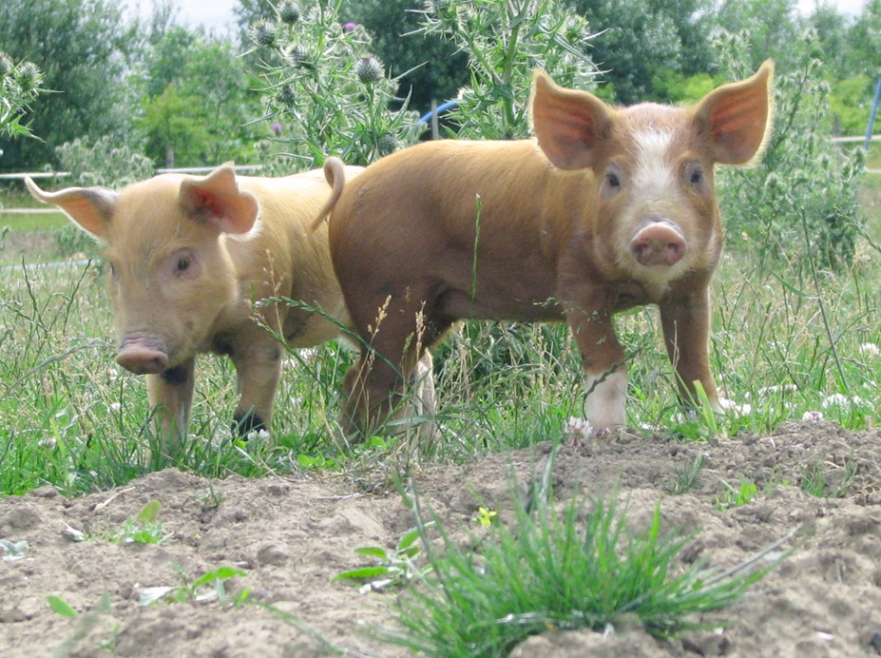
Music 16C
16C final composition!

Slide 2
A song or instrumental composition ca. 24 mm. or more
It must begin and end in the same key and include at the following features:
one modulation
two tonicizations
two examples of mode mixture

Slide 3
Write for yourself, or any number of vocalists or instrumentalists
You will perform your composition during Week 10
You can perform it yourself, or ask someone else to perform it for you
You will be graded on form, harmonic logic, part-writing, analysis, and performance (that is, can you get through it without stopping!)

Slide 4
16C final composition!
Hand in a short score of your analyzed composition on the last day of class.
Indicate RN and inversions, cadences, modulatons with pivots (if applicable), and label the 4 features above in the score.
Draft due week 9, Tues. May 24
Performances week 10, May 31 and June 2
Hand in final Thursday June 2

